Slide 1
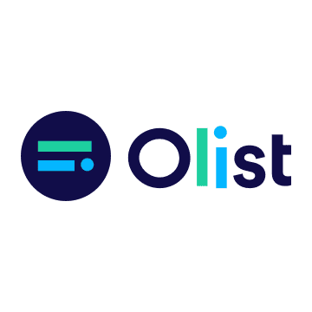
Analysis on the Marketing Funnel

Slide 2
DATA SOURCE
https://www.kaggle.com/datasets/olistbr/marketing-funnel-olist
This dataset was provided by Olist
Olist is the largest ecommerce department store in Brazilian marketplaces
Connects small businesses from all over Brazil to channels without hassle.
Merchants are able to sell their products through the Olist Store & ship them directly to the customers using Olist logistics partners.

Slide 3
Business needs
Which marketing channel (origin) generate the most leads?
What is the volume of leads generated monthly?
Conversation rate % of Marketing Qualified Leads to Seller?
Duration took for SR to convince Leads to join Olist?
Overall Best performing SR and worst performing SR? Top performing SR in closing different Leads Behaviour Profile (Cat, Eagle, Wolf, Shark)?

Slide 4
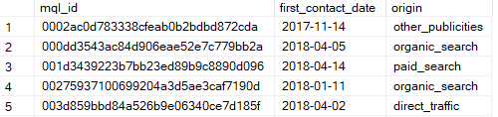
DATASET SIZE
Marketing Qualified Leads Table (8,000 rows x 3 columns)
Closed Deals Table (842 rows x 9 columns)

Slide 5
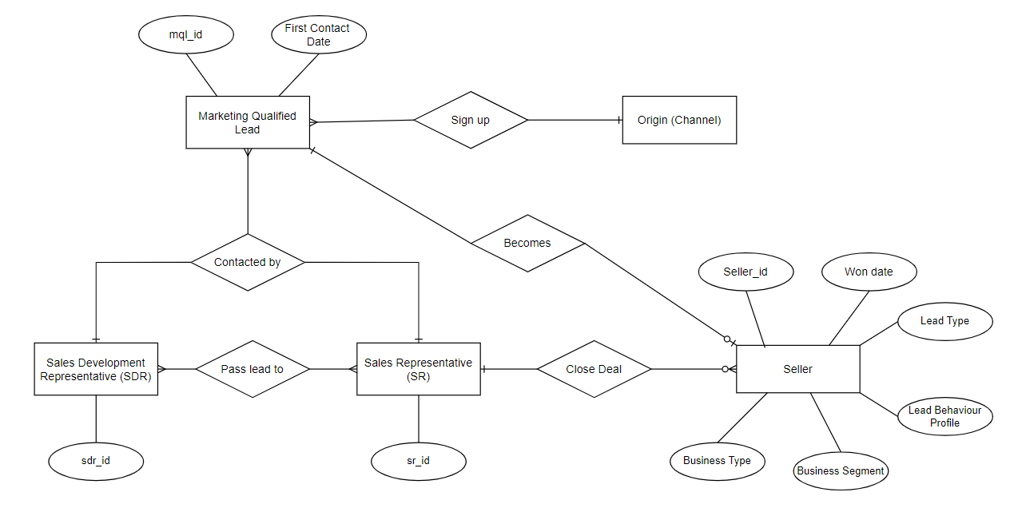
ER Diagram

Slide 6
Schema and Table Diagram

Slide 7
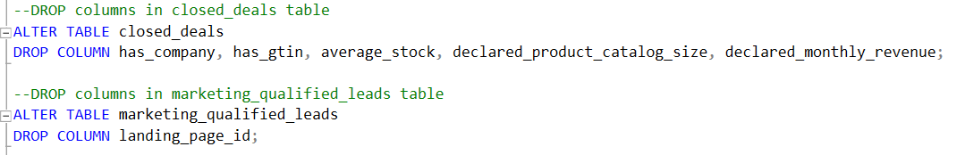

DATA Preparation
Dropping of redundant columns
Change of data type

Slide 8
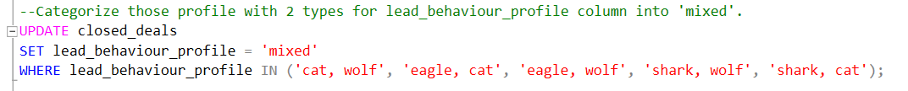
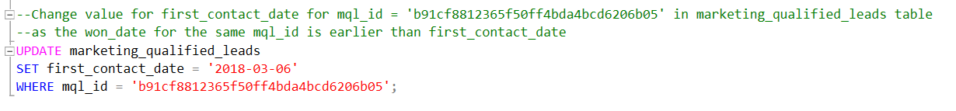
DATA Preparation
Updating of values

Slide 9
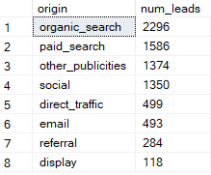
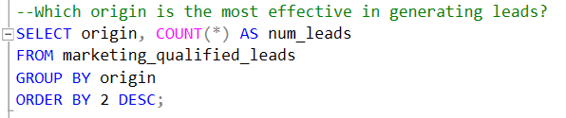
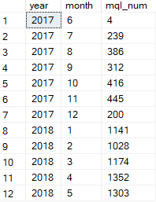
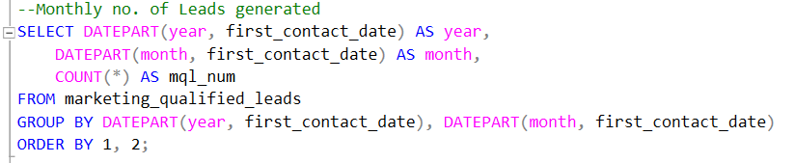
Marketing channel effectiveness

Slide 10
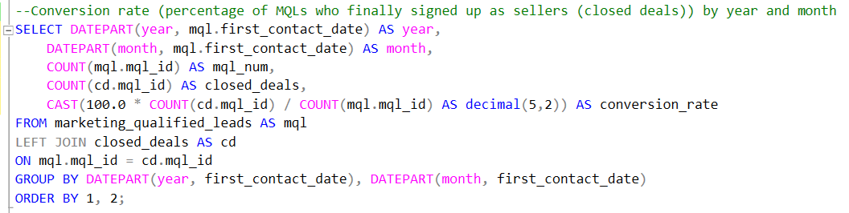
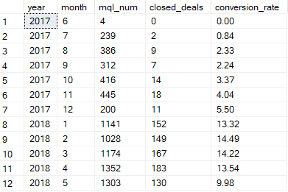
Conversion rate

Slide 11
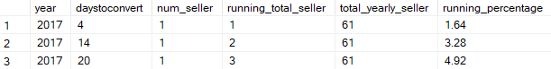
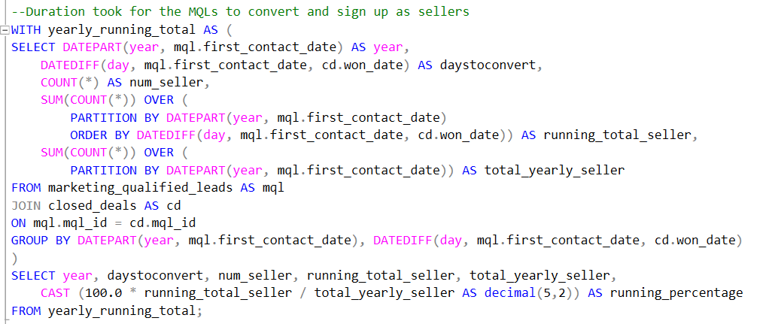
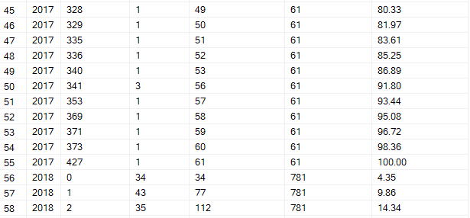
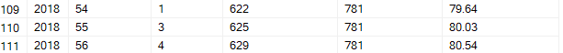

Duration took for Leads to sign up as sellers
. . .
. . .
. . .

Slide 12
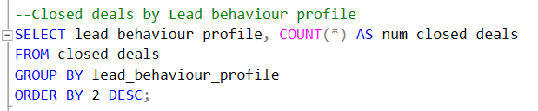
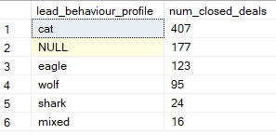
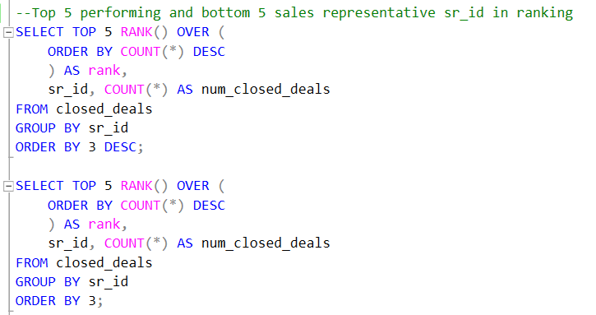
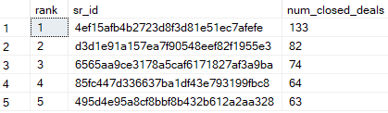
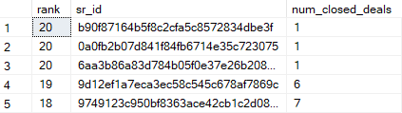
Sale representative performance
Behaviour_profile | DISC_profile | Description
Cat | Steadiness | Emphasis on cooperation, sincerity, dependability
Eagle | Influence | Emphasis on relationships, influencing or persuading others, openness
Wolf | Conscientiousness | Emphasis on quality and accuracy, expertise, competency
Shark | Dominance | Emphasis on accomplishing results, the bottom line, confidence

Slide 13
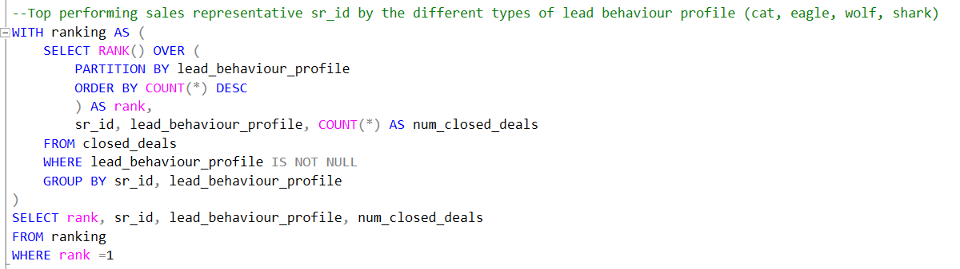
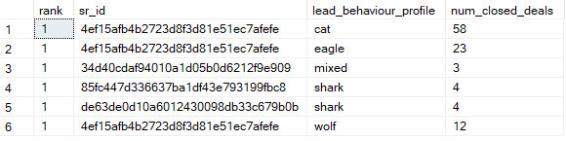
Sale representative performance

Slide 14
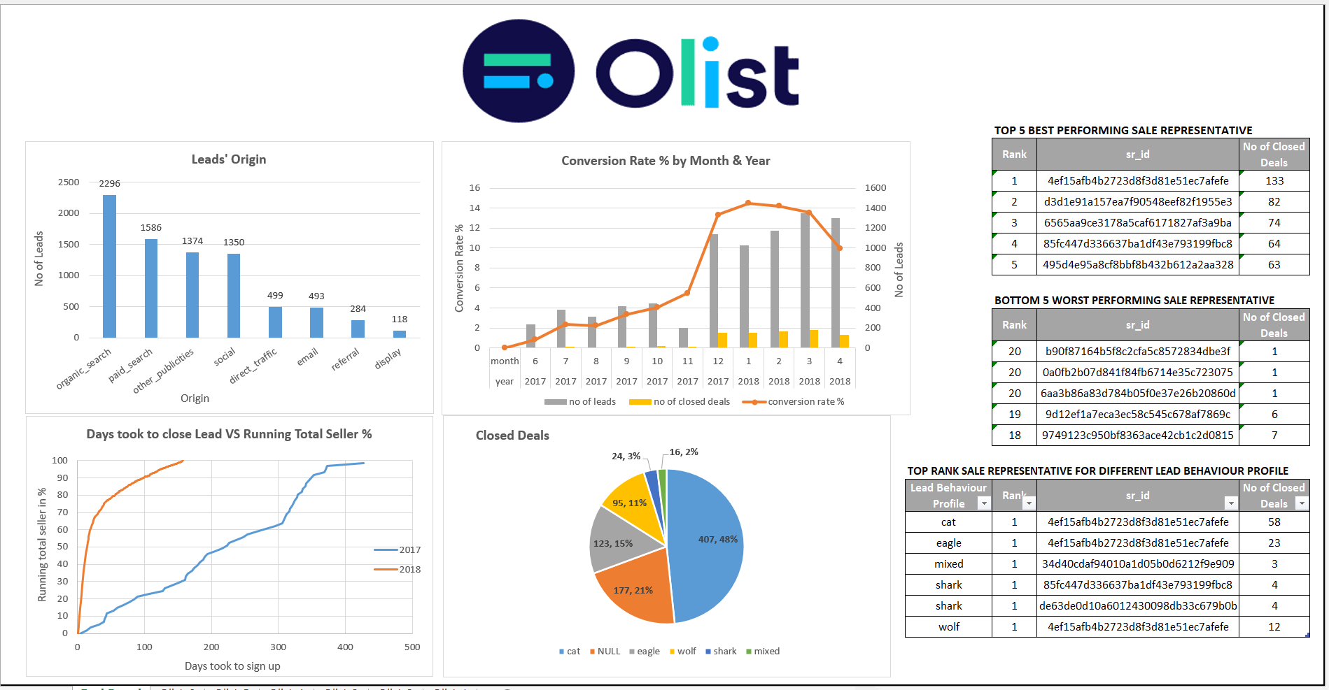

Slide 15
INSIghts
Organic search is the first biggest contribution in leads generation followed by Paid search, Other publicities and Social.
Almost half of the closed deals are cat (cooperation-focused), followed by eagle (relationship-focused), wolf (accuracy-focused) and shark (result-focused) with the lowest conversion rate of 3%.
Sales performance could be improved by matching Sales Representatives with leads based on behaviour profile and conducting a review of Sales Representatives’ skill and equip them with the right sales strategies.

